Slide 1
QUIZ APPLICATION USING PYTHON GUI & DBMS
PRESENTED TO YOU BY : MANIKANTA RAYALA-11914214
OJASWINI SHARMA-11914839
RESHMI-11913918
SUBMITTED TO : CHAVI KAPOOR-23590

Slide 2
CONTENTS
Objectives
Description of project
Work division
Detailed explanation about project
Conclusions and results
References

Slide 3
OBJECTIVES
To create GUI of Quiz Application.
To involve DBMS to store data of user.
To create user friendly interface which can be accessed by everyone.
To understand the working of various modules/libraries used in the project.
To test general knowledge skills of user in different sections.

Slide 4
PROJECT DESCRIPTION
Attractive User Interface
Timer for each section
Database connectivity to store data of user
3 different sections for user to give a test
Exit button at the end of application.

Slide 5

WORK DIVISION
Ojaswini
Manikanta
Reshmi

Slide 6
ALL ABOUT QUIZ APPLICATION

Slide 7
EXPLANATION ABOUT PROJECT
This project is completely coded in python v3.8 64 bits
Modules used are tkinter, mysql.connecter
It includes 6 windows starting from Info window to the exit window
Including SQL database connectivity to store and fetch details of user
Calculate score of user for the questions he/she attempted

Slide 8
LETS KNOW MORE ABOUT THE APPLICATION USING SOME SCREENSHOTS OF IT.

Slide 9
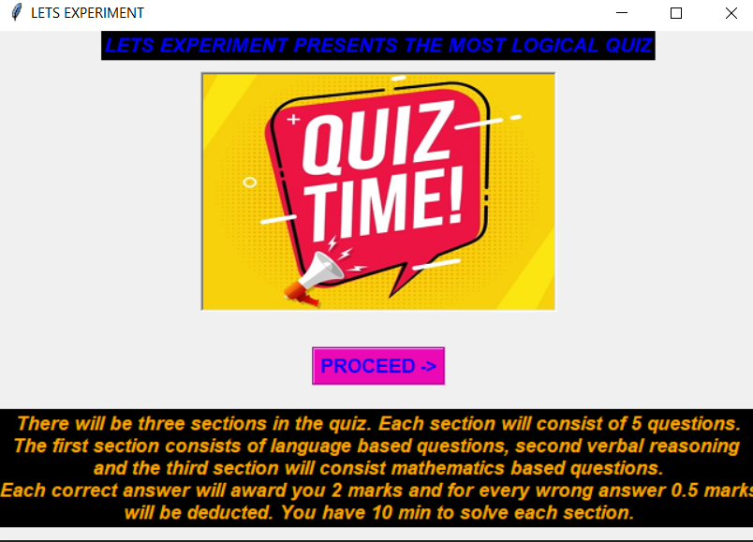
OUR STARTING PAGE

Slide 10
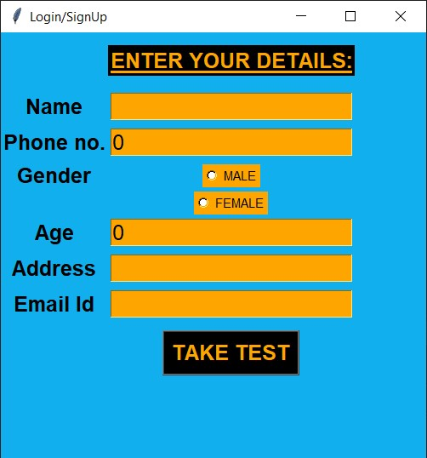
LOGIN/SIGNUP PAGE

Slide 11
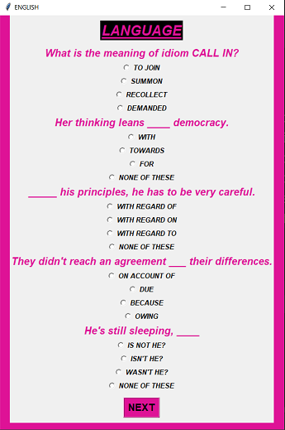
SECTION-1 ENGLISH

Slide 12
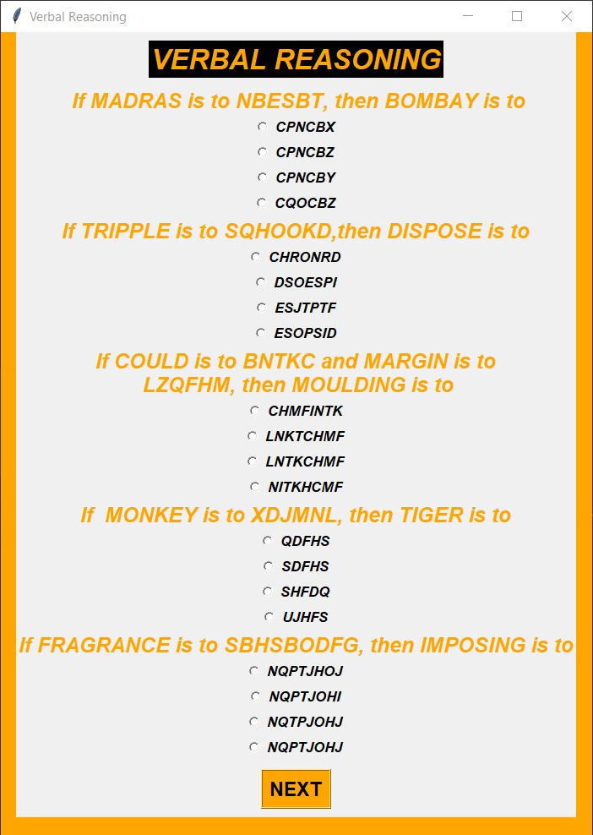
SECTION-2 VERBAL REASONING

Slide 13
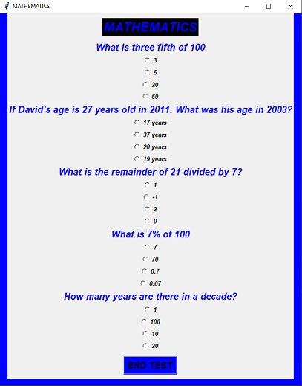
SECTION-3 MATHEMATICS

Slide 14
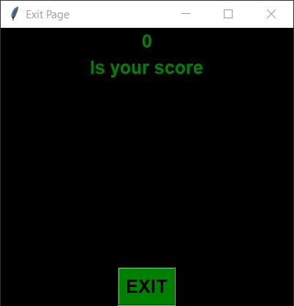
EXIT PAGE

Slide 15
CONCLUSIONS
Successfully implemented theoretical GUI practically
Learnt to implement Database connectivity with python
Successfully drawn the end product using modules used
This project is capable of testing knowledge skills of user and know his competition.

Slide 16
REFERENCES
google.com
stackoverflow.com
geeksforgeeks.org/sql-using-python
effbot.org/tkinterbook/

Slide 17
You can get the code on:https://github.com/OjaswiniSharmaHacker/pythonquiz
Thank You
Have a Nice Day ☺

